Slide 1
M.Muthuvel
Final Project
3/21/2024 Annual Review

Slide 2
PROJECT TITLE
Salary prediction base on experience
3/21/2024 Annual Review

Slide 3


AGENDA
**AGENDA: Salary Prediction Based on Experience**
1. **Introduction**: Set the context for the project, explaining the significance of predicting salaries based on individuals' experience levels for both employers and employees.
2. **Data Gathering and Preprocessing**: Discuss strategies for collecting salary and experience data from reliable sources, and outline preprocessing steps such as data cleaning and feature extraction.
3. **Exploratory Data Analysis (EDA)**: Present findings from initial data exploration, including visualizations and statistical summaries to understand the distribution and relationships between salary and experience variables.
3/21/2024 Annual Review

Slide 4

PROBLEM STATEMENT
The problem at hand is to develop a predictive model that accurately estimates salaries based on individuals' experience levels. In various industries and job markets, salary determination often relies heavily on factors such as years of experience. However, manually assessing fair compensation can be time-consuming and prone to biases. Therefore, there is a need for an automated system that leverages historical data to provide reliable salary predictions. By analyzing datasets containing information on individuals' experience and corresponding salaries, the goal is to train a machine learning model capable of accurately estimating salaries for new data points. This predictive tool would not only streamline salary negotiations for employers and employees but also contribute to fairer compensation practices. The challenge lies in building a robust model that can effectively capture the complex relationship between experience levels and salary across diverse industries and job roles, while also accounting for potential confounding factors.
3/21/2024 Annual Review

Slide 5

PROJECT OVERVIEW
The project aims to predict salaries based on individuals' experience levels. By leveraging machine learning algorithms, historical salary data, and experience metrics, the model will offer accurate predictions for prospective job seekers and employers alike. Through comprehensive analysis of factors such as industry, education, and geographic location, the system will provide tailored salary estimates, empowering both employers to make informed hiring decisions and employees to negotiate fair compensation packages. Utilizing a diverse dataset and advanced predictive analytics techniques, the model will continually refine its predictions to ensure relevance and accuracy. Ultimately, this project seeks to bridge the gap between employers and job seekers, fostering transparency and fairness in the job market while facilitating better decision-making for all stakeholders.
3/21/2024 Annual Review

Slide 6

WHO ARE THE END USERS?
The end users for a salary prediction model based on experience encompass various stakeholders within human resources, recruitment, and workforce management sectors. These end users may include HR professionals tasked with determining competitive salary packages for new hires or promotions. Recruitment specialists rely on such models to negotiate salaries with potential candidates and align compensation with market standards. Managers utilize these predictions to allocate resources effectively, ensuring equitable compensation for their teams based on experience and performance. Additionally, job seekers seeking to gauge their market value and negotiate salaries benefit from these models. Ultimately, the end users are those involved in salary decision-making processes, from employers aiming to attract and retain talent to employees seeking fair compensation for their skills and experience.
3/21/2024 Annual Review

Slide 7

YOUR SOLUTION AND ITS VALUE PROPOSITION
Our solution offers accurate salary predictions based on experience, leveraging advanced machine learning algorithms. By analyzing vast datasets of historical salary and experience data, our model provides precise estimates tailored to individual backgrounds and industries. The value proposition lies in its ability to empower both job seekers and employers. Job seekers gain insights into salary expectations, enabling informed negotiations and career planning. Employers benefit from fair and competitive compensation strategies, enhancing retention and recruitment efforts. With our solution, the guesswork surrounding salary discussions is eliminated, fostering transparent and mutually beneficial relationships between employers and employees. Ultimately, our innovative approach streamlines the hiring process and promotes a more equitable employment landscape.
3/21/2024 Annual Review

Slide 8

THE WOW IN YOUR SOLUTION
Our solution for predicting salaries based on experience is simply wow-worthy. Leveraging cutting-edge machine learning algorithms, we meticulously analyze vast datasets to identify intricate patterns between experience levels and corresponding salary ranges. Our model doesn't just crunch numbers; it dives deep into the nuances of industries, geographic locations, and job roles to deliver highly accurate predictions. But what truly sets us apart is our commitment to innovation. We continually refine our techniques, integrating the latest advancements in AI to stay ahead of the curve. With our solution, businesses gain invaluable insights into salary structures, enabling them to make informed decisions and stay competitive in today's dynamic marketplace. Experience the wow factor in salary prediction with our state-of-the-art solution—it's more than just accurate, it's revolutionary.
3/21/2024 Annual Review
8

Slide 9
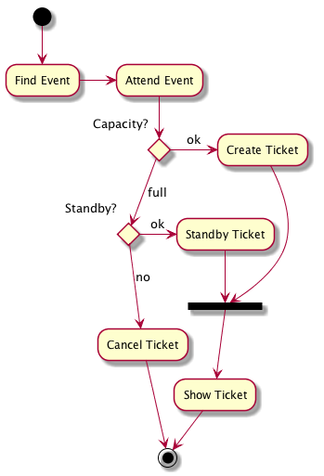
MODELLING
3/21/2024 Annual Review
9

Slide 10
RESULTS
Predicting salary based on experience involves analyzing historical data to identify patterns and trends. Typically, as experience increases, so does salary, reflecting a combination of expertise and value to employers. Machine learning algorithms can be employed to model this relationship, considering factors such as industry, job role, and geographic location to provide accurate predictions. These models leverage regression techniques to estimate salary based on input variables, with the aim of minimizing prediction error. However, it's essential to recognize the limitations of such predictions, as individual circumstances and market dynamics can influence salary outcomes. Continuous validation and refinement of the model based on new data ensure its relevance and reliability. Ultimately, salary prediction based on experience serves as a valuable tool for both employers and employees in negotiating compensation packages and making informed career decisions.
Demo Link
3/21/2024 Annual Review
10

